Slide 1

Marri Laxman Reddy Institute of Technology and Management
Department of Computer Science and Engineering
A project on
Road Lane-Line Detection Using A.I
Submited By,
SHIVA.S (207Y1A05F9)
BHARATH TEJESH (207Y1A05C2)
Under The Guidance Of,
Dr. YUSUF MULGE (professor)

Slide 2
Lane Line Detection Using Artificial Intelligence
207Y1A05F9
207Y1A05C2

Slide 3
INDEX
ABSTRACT
INTRODUCTION
SCOPE
CHALLENGES
EXISITING SYSTEM
PROPOSED SYSTEM
SOFTWARE REQUIREMENTS
HARDWARE REQUIREMENTS
DESIGN & ARCHITECTURE

Slide 4
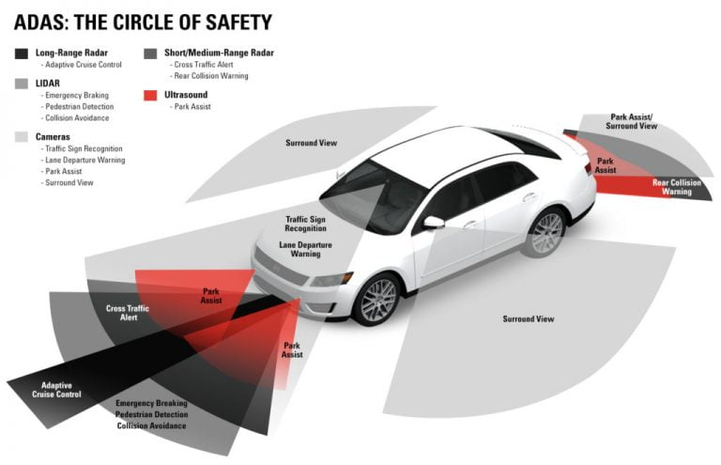
ABSTRACT
Lane line detection is an essential part of autonomous vehicles to identify lane marking on the road using camera and computer vision(CV).
Artificial intelligence (AI) plays a crucial role in detecting lane lines accurately and quickly.
Lane line detection using AI can improve driving safety and reduce accidents caused by lane deviation.
1

Slide 5
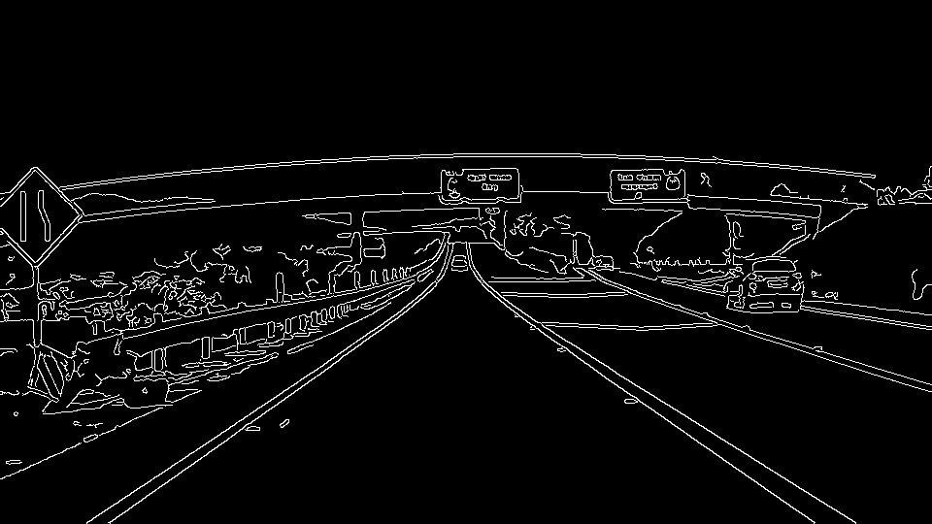
INTRODUCTION
As the need for an intelligent transport system is growing rapidly, lane line detection has gained a lot of attention recently. Aiming at the problem that the YOLOv3 algorithm has low accuracy and high probability of missed detection when detecting lane lines in complex environments, a lane line detection method for improving YOLOv3 network structure is proposed. The improvement is focused on detection speed and accuracy.
The methods used in the code are:
1. Open CV (Open Source Computer Vision)
2. Grayscale
3. Gaussian blur
4. Canny edge detection
5. Region of interest (ROI)
6. Hough Transform
2

Slide 6
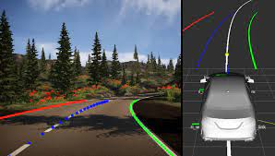
SCOPE
At present, the main methods of lane line detection include the method of extracting road features by machine vision, the method of establishing road model for detection
The method of multi-sensor fusion detection The method of extracting road features by machine vision mainly uses machine vision technology
3

Slide 7
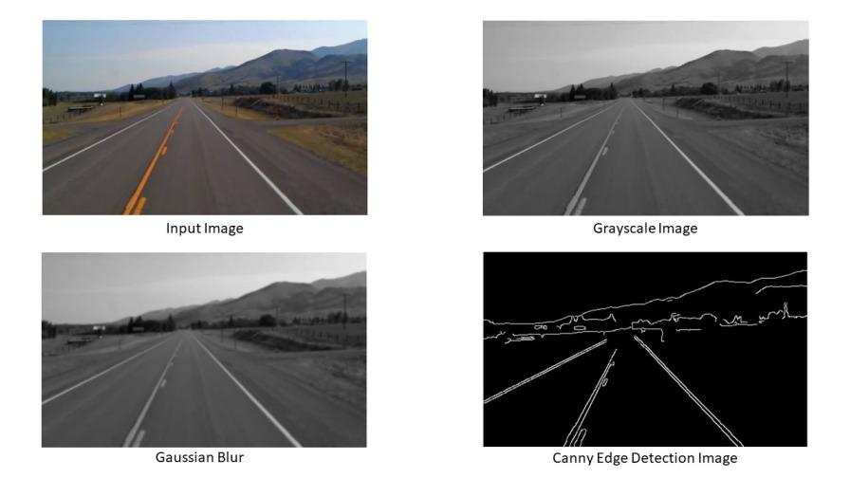
CHALLENEGES
Lane marking detection is challenging under adverse weather, especially in rain. Rain affects the visibility by changing the amount of light reflected from the road and splashing of rain periodically blocks vision through the car windshield. Colored (yellow, blue etc.)
AI models are trained on millions of annotated images to learn lane line features.
Transfer learning can help to improve accuracy by leveraging pre-trained models.
Hyperparameter tuning is crucial to optimize model performance.
5

Slide 8
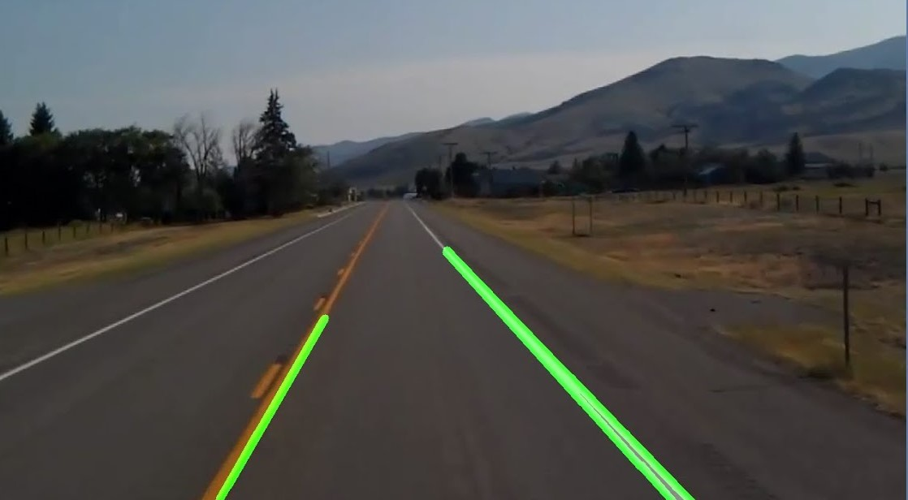
EXISTING SYSTEM
Real-time lane line detection requires high-performance hardware.
GPUs and specialized hardware like FPGAs can accelerate lane line detection.
Real-time detection is essential for autonomous vehicles and ADAS.
6

Slide 9
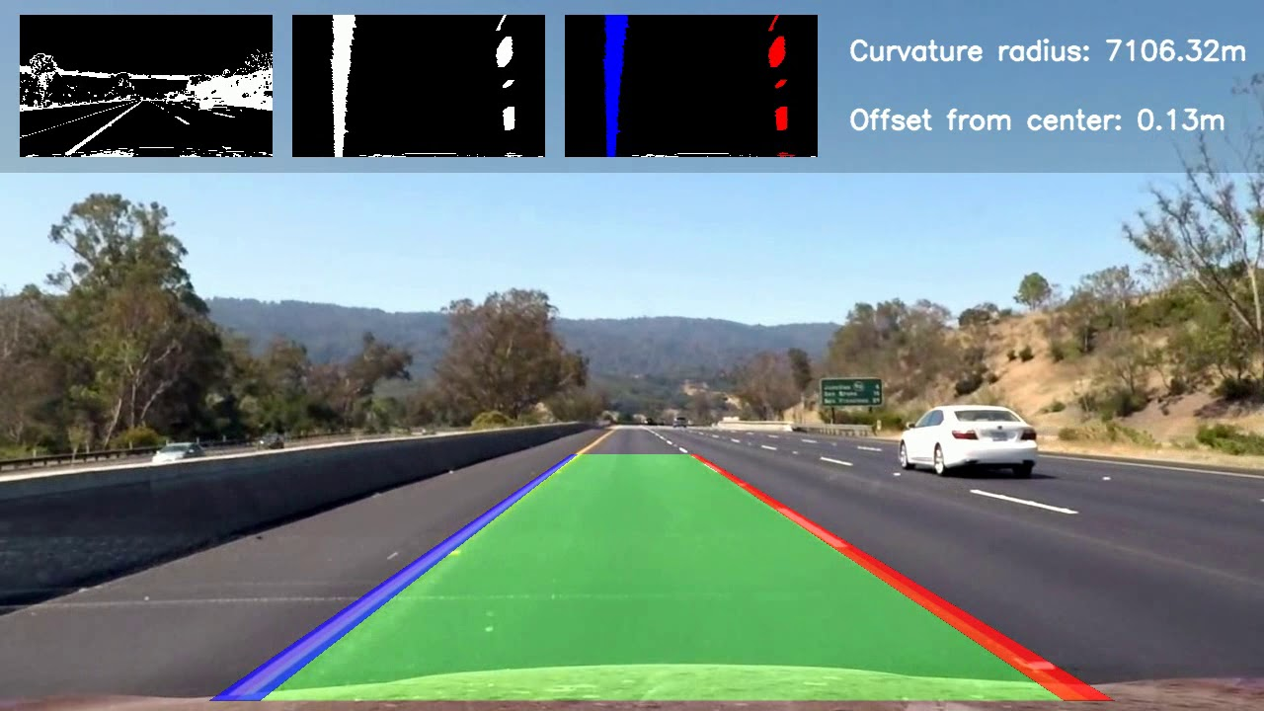
PROPOSED SYSTEMS
proposed efficient lane detection by using curve modelling with the convolution-based feature. This method mainly uses curve models as a holistic representation of lane lines, which naturally eliminates occlusions and predicts a variable number of lines.Lane line detection can be challenging in adverse weather conditions like rain and snow.
AI-based methods can handle challenging conditions by learning from diverse data.
Advanced techniques like semantic segmentation can improve accuracy in challenging conditions.
7

Slide 10
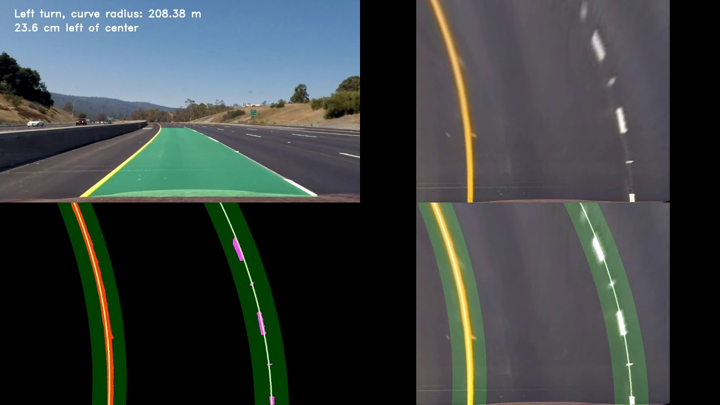
SOFTWARE REQUIREMENTS
These methods can detect lane lines accurately under different lighting and weather conditions.
1. OpenCV: It is used by the camera’s to detect the objects.
2. GrayScale: Converting Color image to Black & white.
3. Gaussian Blur: Used to reduce the noise and smooth out details.
4. Canny Edge: It is Used to Detect the Edges.
5. Region of Interest(ROI): It focuses on specific area of a video/image.
6. Hough Transform: Used to detect shapes in an image (lines,circles)
8

Slide 11
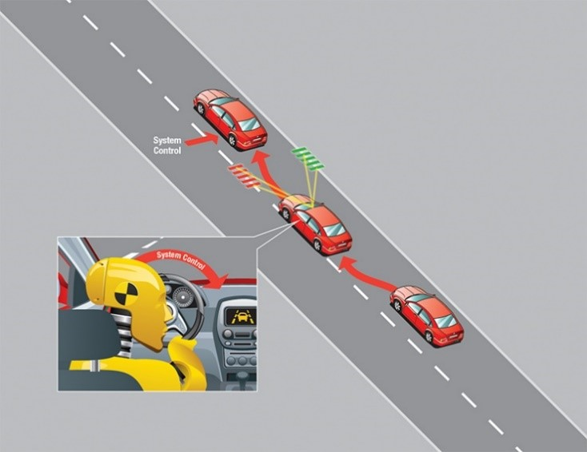
HARDWARE REQUIREMENTS
CPU: A multi-core processor (e.g., Intel Core i5 or higher, AMD Ryzen) can handle basic line and lane detection algorithms.
GPU (Graphics Processing Unit): A dedicated GPU, especially from NVIDIA (such as GTX or RTX series), can significantly accelerate the processing of computer vision tasks due to its parallel processing capabilities.
Memory (RAM): A minimum of 8GB RAM is recommended, but higher amounts (16GB or more) may be beneficial for processing larger images or videos.
Storage: Adequate storage space for storing images or videos, and the related datasets.
Camera or Sensor: High-resolution cameras or sensors with good image quality can improve the accuracy of line and lane detection.
External Hardware (Optional): For real-time applications, specialized hardware like FPGA (Field Programmable Gate Array)
9

Slide 12
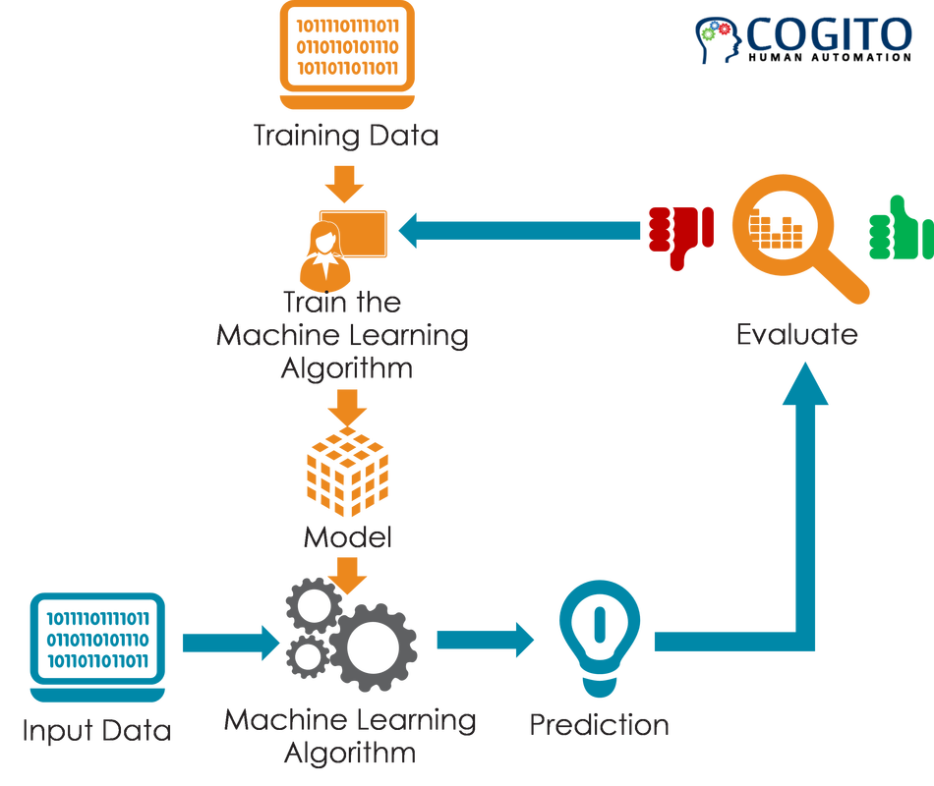
DESIGN &ARCHITECTURE
Designing plays a crucial role in line and lane detection
Data collection is a critical step in training AI models.
High-quality data with diverse road conditions and lighting is essential.
Accurate annotation of lane lines is crucial for effective training.
4

Slide 13
Future of Lane Line Detection
Future advancements in AI and hardware can improve the accuracy and speed of lane line detection.
AI-based lane line detection can be integrated with other ADAS features like automated emergency braking and adaptive cruise control.
Lane line detection can play a crucial role in achieving fully autonomous driving.
10

Slide 14
Conclusion
Lane line detection is an essential part of autonomous vehicles and ADAS.
AI-based lane line detection is more accurate and reliable than traditional methods.
AI-based lane line detection can improve driving safety and reduce accidents caused by lane deviation.
11

Slide 15

Thank You
A final slide thanking the audience for their attention and inviting further discussions.
15

